Slide 1

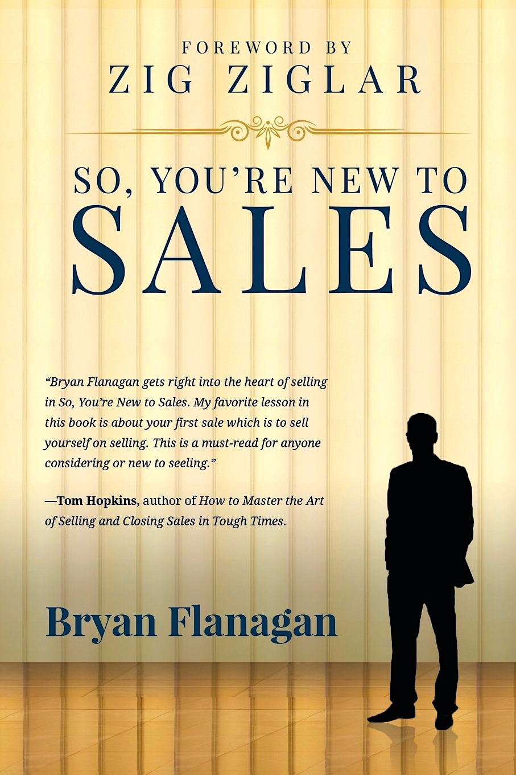
Closing on Objections
Bryan Flanagan
flanagantraining.com
Bryan@flanagantraining.com

Slide 2
5 Reasons Your Prospects Don’t Buy
No Want
No Need
No Hurry
No Money
NO TRUST

Slide 3
Topics for Today
Sell more!
The Psychology of Closing on Objections
Professionally deal with Objections and Resistance
Manage the concern then overcome with evidence
Get serious about our sales success – A. A. F. T. O.

Slide 4
Objections: Friend or Foe?
Objection: anything your buyer says or does which may interfere with attaining your sales objective.
Caution: not all buyer’s questions are objections…they could be asking for clarification or more information.
It may not be “no”…it could be I don’t “know” enough…
But either way I hate objections….

Slide 5
Why are we hesitant to ask?
Don’t want to face resistance! The Formula: LCETAA
Lack confidence – process takes pressure off the person
Don’t want to be viewed as “sales-y” – the intent behind your technique determines your ethics
Skipped a stage(s) in the sales process – P.R.O.C.E.S.S. – Page 12
Confuse rejection with refusal – one is personal, one professional
We ask for commitment in order to feed our family – not our ego!

Slide 6
Closing = the logical conclusion of your effort
Think about a client you’ve sold recently: you processed it, it went to close, it closed, and you received your commission ..
Three questions:
1. Is the client still in the house?

Slide 7
Closing = the logical conclusion of your effort
Think about a client you’ve sold recently: you processed it, it went to close, it closed, and you received a commission check..
Three questions:
Is the client still in the house?
Do you still have all the money from the commission?

Slide 8
Closing = the logical conclusion of your effort
Think about a client you’ve sold recently: you processed it, it went to close, it closed, and you received a commission check..
Three questions:
1. Is the client still in the house?
2. Do you still have all the money from commission on the sale?
3. Who got the best deal? You or the client????

Slide 9
Manage Objections via LCETAA – Page 22 - 24
Listen - for content and intent
Clarify – “Why is that a concern? Help me understand. So, your real concern is _______?”
Empathize – “I understand.”
Test – is this true or false or stall – “Suppose …” Isolate/Validate
Answer – overcome with evidence …
Agree – it’s been satisfactorily answered …”Does that answer it?”

Slide 10
What Objections Do You Face Each Day?
1.
2.
3.
4.

Slide 11
Objection: “I’m happy with my realtor.”
What do you like?
Dislike?
What would you change?
“Nothing, I’m happy!”

Slide 12
Objection: “I’m happy with my realtor.”
What do you like? Dislike? What would you change? (Clarify)
Thanks for sharing. (Empathize)
How long ago did you start using? What criteria did you use in selection? How have those criteria changed? Suppose you could receive these better than receiving now? Is it beneficial enough to talk to _______? (Test)
Loan officer will explore the value of our services. (Answer)

Slide 13
Overcome with Evidence
What evidence can you provide to support your claims?
Team statistics
Industry averages
3rd party references
Satisfied homeowners
Satisfied realtors
Try us out: “See for yourself”

Slide 14
Develop a “Closing Attitude”
The Jay Hellwig Story
“Zig didn’t teach me a closing technique as much as he taught me a closing attitude. The attitude helps me close more sales than the techniques do.”

Slide 15
What must be in place to Close successfully?
The thorough completion of each Stage of PROCESS
A “helping attitude”
The strong trust you’ve built with the buyer
Strong belief – in product solution, in the buyer, and in yourself
An effective and personalized presentation
A keen awareness of the client’s Value, Advantages, Benefits
The confidence you’ve done your job in understanding the needs from the client’s P O V

Slide 16
Closes – Closes - Closes
The Puppy Dog Close Sharp Angle Close
The Assumptive Close The Feel Good Close
Alternative of Choice Close Either Or Close
The Probability Close Minor Decision Close
The Ben Franklin Close Tie Down Close
Right Choice Close The Soft Close
The Just Ask Close The Here Goes Close

Slide 17
How to ask for commitment:
Mr. Watts, why don’t you give us a try?
Are you ready to move forward?
If there are no more questions, let’s complete the application.
If I may summarize. You’ve agreed to the _________ and __________. Is there anything keeping us from moving forward today?
It seems our system best fits for your needs. Would you agree?

Slide 18
Flanagan, if it were only that easy!
Ask, don’t tell:
“Mr. Realtor, what do you need to see to from us to feel comfortable we can outperform your current provider?”
Keep your head (not your foot) in the door:
“In the future, what would capture your attention/interest?”
“What could I show you that would warrant/earn a meeting?”

Slide 19

Bryan Flanagan
3912 Wilshire Drive Plano, Tx 75023
214.505.5109
flanagantraining.com
Bryan@flanagantraining.com

